Slide 1
introducing DRUGIEE
Sunny Patel
Notes:
This presentation demonstrates the new capabilities of PowerPoint and it is best viewed in Slide Show. These slides are designed to give you great ideas for the presentations you’ll create in PowerPoint 2011!
For more sample templates, click the File menu, and then click New From Template. Under Templates, click Presentations.

Slide 2
Purpose
1
2
3
Provide quick access to drug information
Quickly find drug interactions
Reduce clinical errors

Slide 3
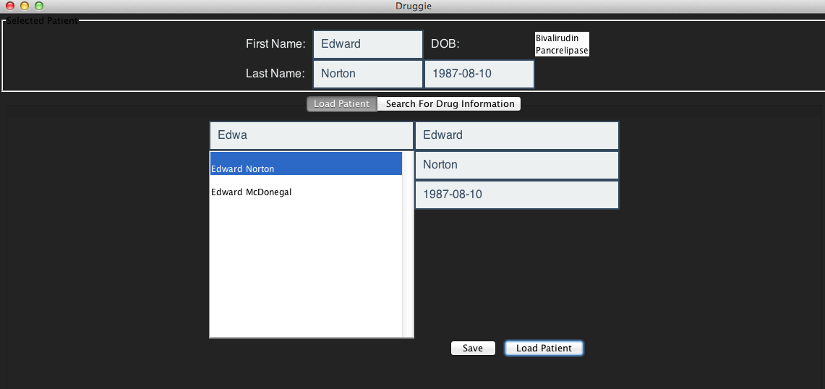
Getting Started : loading patients
Design and organize

Slide 4
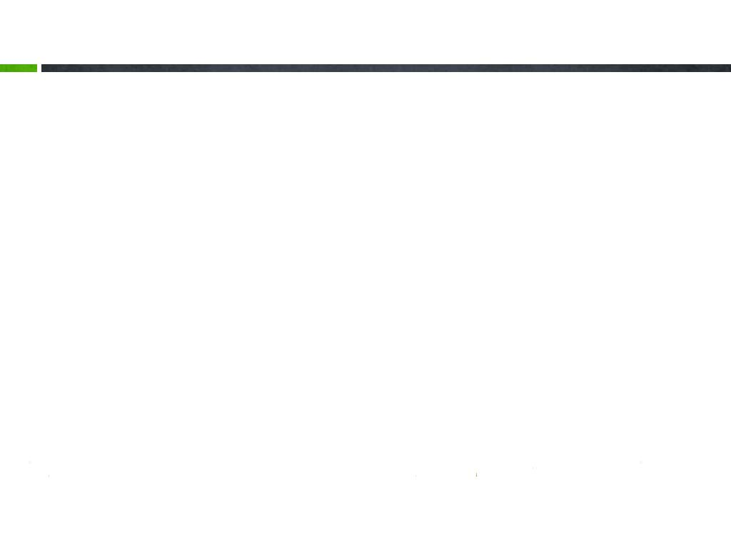
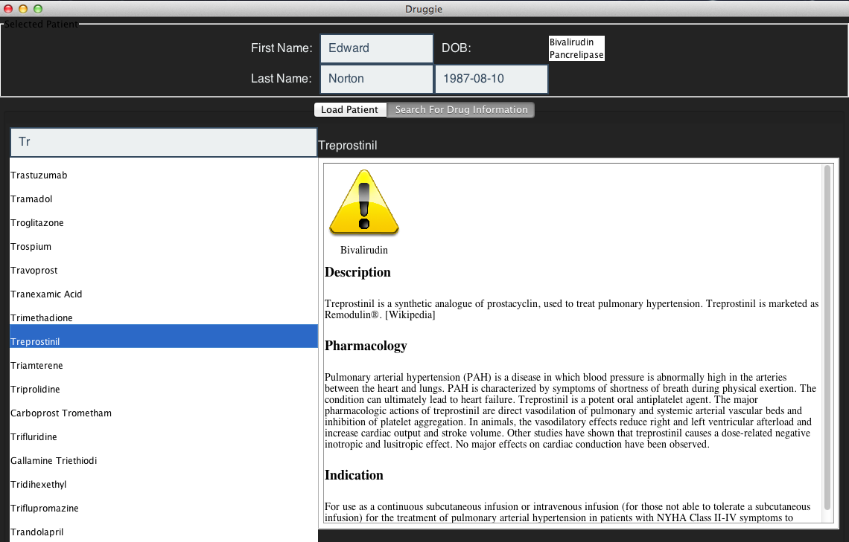
SEARCHING FOR DRUGS

Slide 5





DRUGIEE
What’s Your Message?

